Slide 1


Software Engineering Department Braude College
Capstone Project Phase B 23-2-D-19
Supervisors:
Alexander Keselman
Present:
Shaked Arish: 311420384
Sean Friedman: 204404511

Slide 2
Overview
1
2
3
4
Introduction
The Problem
Our Project
Requirements
5
6
7
8
Solution Description
Project Indicators
Challenges
Conclusion

Slide 3
Introduction
In our modern world, social platforms play a significant part in our lives and became a powerful way for individuals and companies as one to:
Express ideas
Share information
Build brand
Connect with their target audience
Notes:
It became a powerful tools for anyone who want to and give the ability to:

Slide 4
Introduction
Short videos especially have become incredibly popular, on platforms like TikTok and YouTube due to their ability to capture the attention of the user.
These videos provide a convenient way for users to engage with content quickly and efficiently.
Notes:
Short videos especially have the ability to capture the attention of the user.
These videos provide a convenient way for create a content quickly and efficiently

Slide 5

The Problem:
require editing skills
time consuming
Leverage the power of AI tools
Notes:
The ability to leverage the power of AI

Slide 6

Our Project
Our project aims to change the process of generating smart content, by developing a platform that leverages the power of AI to help individuals and businesses from all backgrounds with no previous knowledge to produce high-quality video content with ease.

Slide 7

System Main Requirements:
Acceptable Time for Video Generation
Design Simple and Accessible
Script Editing and Audio Selection
Notes:
We will keep a simple and modern design, consistent throw all the stages.
We will make examples on the site for the process

Slide 8

Solution Description

Slide 9

User Video Description
The creation of a new video starts from a welcoming react web application that designed with the help of Taillwind CSS.
The first phase in creating a video project involves collecting user input. Users are prompted to provide a description for their video, which serves as the foundation for the project.
Notes:
By answering this few simple questions in the form,
The users provide us with the necessary information to generate their video.

Slide 10

Script Creation
Integrate user input with a sophisticated unique prompt
Creating script using OpenAI API
Divide script into scenes
User script editing option
Notes:
The produced script is about the subject of the user according to his preferences in terms of
creativity and the nature of the video

Slide 11

Voiceover
Voice selection
Generate voiceover with Azure TTS (Text-To-Speech)
Generate subtitles using Azure STT (Speech-To-Text)

Slide 12

Pexels API
Extract keywords from each scene with a pre-designed prompt for ChatGPT
Search videos based on keywords via Pexels API
Process downloads videos
Notes:
By understanding the context of each scene in the script, we will make an accurate request for a relevant video API and generate suitable videos that align with the script.

Slide 13

Merge Components
Finally, the last step is merging the selected videos, along with the voiceover , subtitles and background music to create a cohesive and captivating video that truly brings the user's vision to life.

Slide 14

Video Is Ready…
Notes:
The user can save the video, download it and share it on social networks

Slide 15

Project Indicators
We successfully achieved our goals, our system able to generate a high-quality engaging videos with acceptable times while keeping the user experience simple and easy to use by using top edge technologies and integrating it with them.

Slide 16
Constraints and Challenges
Integration with multiple API’s
Generate accurate and high-quality content that meets the user's intent
Real Time performance
Quality control and filtering
Deployment
Notes:
Quality Control and Filtering

Slide 17

Conclusion

Slide 18
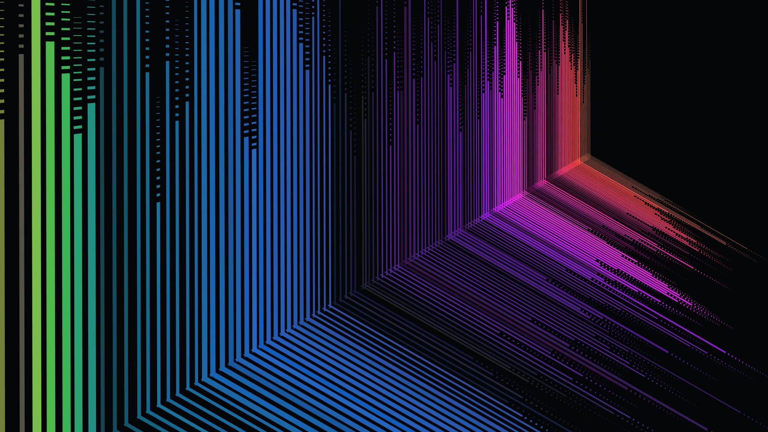
Thank You

